Slide 1
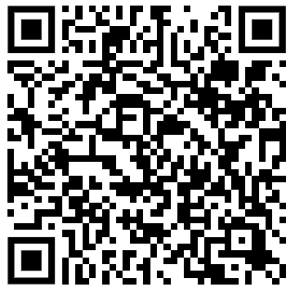
What is this?

Slide 2
Colossians 1:16-18 & Psalm 146:5-10
The death of Christ is worth thinking about because it is not everyday that God dies…

Slide 3
(Matthew 27:45-56) some fantastic events that took place after Jesus died:
V51 The torn curtain or vail
V51b There was an earthquake.
V52 There was a limited resurrection.
V54 Roman officials who crucified him said, “Truly, this was the son of God.”

Slide 4
We all hate it when crimes against us or people we care about goes unpunished, don’t we?

Slide 5
You’ll want to remember these verses….
Listen to:
2 Corinthians 5:15-21
Isaiah 53:1-12

Slide 6
Before he died, Jesus said he would rise from the dead… but they didn’t believe it:
Mat 12:38-40
Well, they didn’t forget this, because when Jesus’s cold dead body was laid in a tomb, they hired soldiers to seal and guard the tomb to be sure that Jesus couldn’t get out.
Matt 27:62-28:15

Slide 7
The resurrection of Jesus happened and because of it, there is some stuff that is possible for all of us.

Slide 8
1. We can be justified (Rm 4:25; 5:1)

Slide 9
2. We can be assured of our own resurrection!
(1 Cor. 15:21-26)

Slide 10
3. Jesus will raise everyone from the dead: Christians will be first and then 1,000 years later, everyone else.
(John 5:27-29)

Slide 11
So What?
Today in this room there are two kinds of people here today:
Believers in the gospel of Jesus Christ
The unbelieving remainder.

Slide 12
Which one are you?

