Slide 1

9:13-34

Slide 2

Introduction
John
9:13-14

Slide 3
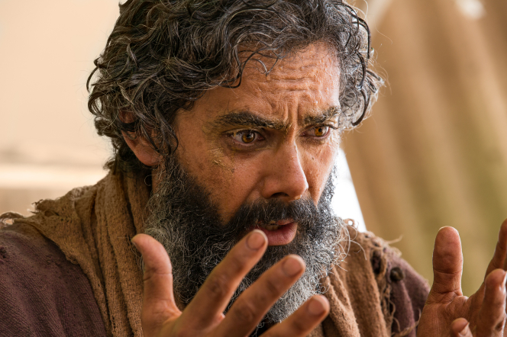
Interrogation
Part One
John
9:15-17

Slide 4

Interrogation
Part Two
John
9:18-23

Slide 5
Interrogation
Part Three
John
9:24-27

Slide 6
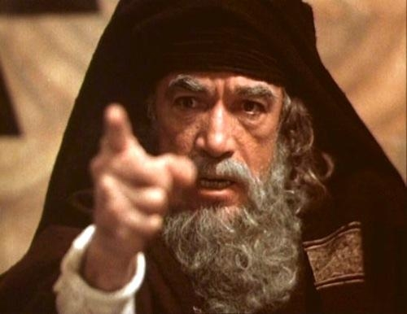
Judgement
John
9:28-34

Slide 7
Judgement
John
5:45-47
John
9:28-34

Slide 8
Judgement
John
9:28-34

Slide 9
